Slide 1
Seizure! Identification and Emergency Management Kelly M Schober, RN, MSN, CPNP, APRN Pediatric Neurology SSM Cardinal Glennon Children’s Hospital Kelly.Schober@ssmhealth.com 314-577-5338 office

Slide 2
Disclosure
I have no relevant financial relationships to disclose.

Slide 3
Objectives
Understand why seizures can look so differently (classification)
Recognize typical characteristics of most common seizure types
Steps to keep students safe during seizure
Rescue medications commonly used in students with seizures

Slide 4
Example #1

Slide 5
Example #2

Slide 6
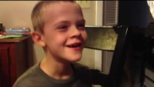
Example #3

Slide 7
Know the Facts!
What is Epilepsy?
1:100 people have Epilepsy in the US
470,000 children <14 years old in US have Epilepsy
For some may be temporary problem or may outgrow in a few years, others may be lifelong
Some may have good control on 1 med, others may take multiple medications or be considered “refractory”
Epilepsy Foundation, www.epilepsy.com

Slide 8
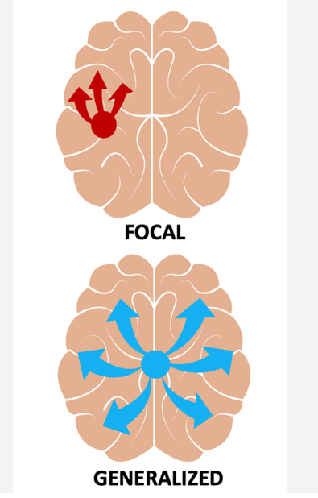
Why do these seizures look so differently?

Slide 9
Seizure Classification
Generalized:
Seizures that occur in both hemispheres of the brain
Examples:
*Generalized tonic-clonic
*Absence
Tonic
Atonic
Myoclonic
Focal
(Previously referred to as Partial)
A seizure that is isolated to a region or hemisphere in the brain
Examples:
1) Focal Aware (Simple Partial)
No loss of consciousness
2) Focal Unaware (Complex Partial)
+LOC or loss of awareness
*Focal seizures can stay Focal OR can secondarily generalize*

Slide 10
How to describe? Brief and basic!
Generalized:
Body posture…
Stiff or limp?
Shaking…
Jerking, twitch or tremor
No change in either?
non-motor type
(subtle eye movement or lid flutter)
Focal:
Body posture, Shaking
(same as generalized)
+
Lip smacking, repetitive picking, clapping or rocking
No change in either?
non-motor type
(but child may report change in sensation, thinking, hearing, vision, stomach symptoms)
Get video!

Slide 11
It’s a seizure, now what?
Don’t!
Put anything in the mouth (it is impossible to swallow your tongue)
Restrain the person
Think seizure is contagious, you can’t catch it from other persons
Think only people with medical problems, autism or behavioral health problems have seizures
Think seizure is still going on just because person is sluggish or not back to baseline (post-ictal = Recovery)
DO!
Stay with the person and time the event, but send someone else for help
Assist them on to ground if they are on elevated surface or chair
Turn them on the side if they are not aware or not responsive to you
get video to give to parents if possible
Call 911 if:
1st time seizure
Any seizure that lasts >5minutes
Having back-to-back seizures
turning blue or difficulty breathing
seizure occurs in water
injury has occurred during seizure

Slide 12
More to “Do’s”! Seizure Action Plan and Rescue Medication
Seizure Action Plan:
Document specific for each child:
Type/description/frequency of past seizures
First aid/emergency care specific for the child
Seizure Precautions for that child
Rescue med if indicated and name/route/when to give
Seizure Rescue Medication:
Diastat → Rectal, any age (only option for <5years)
Valtoco→ Nasal, 6&up, 1 or 2 sprays (depends on dose)
Nayzilam→ Nasal 12&up, 1 spray (only comes in one dose)

Slide 13
Co-morbidities of Epilepsy
1. ADHD:
Most common co-occurring disorder in Epilepsy
30-40/100 people with epilepsy will have ADHD vs. 7-9/100 in general population
2. Learning disabilities
Mood disorders
Anxiety
Measures of support for some students: 504 plans, establishing rapport with school counselor, and/or therapist, counselor outside of school, Neuropsychological testing

Slide 14
Thank you for partnering with us to support students with seizures!
Everyone know the Seizure Action Plan
Be aware of Seizure precautions & rescue medications if indicated
Every child with seizures is unique but be aware of common co-existing conditions
OK to ask questions! Release of Information can be very helpful

Slide 15
QUESTIONS

